Slide 1

Text Summarization
Notes:
Lecture 9: Text Summarization

Slide 2
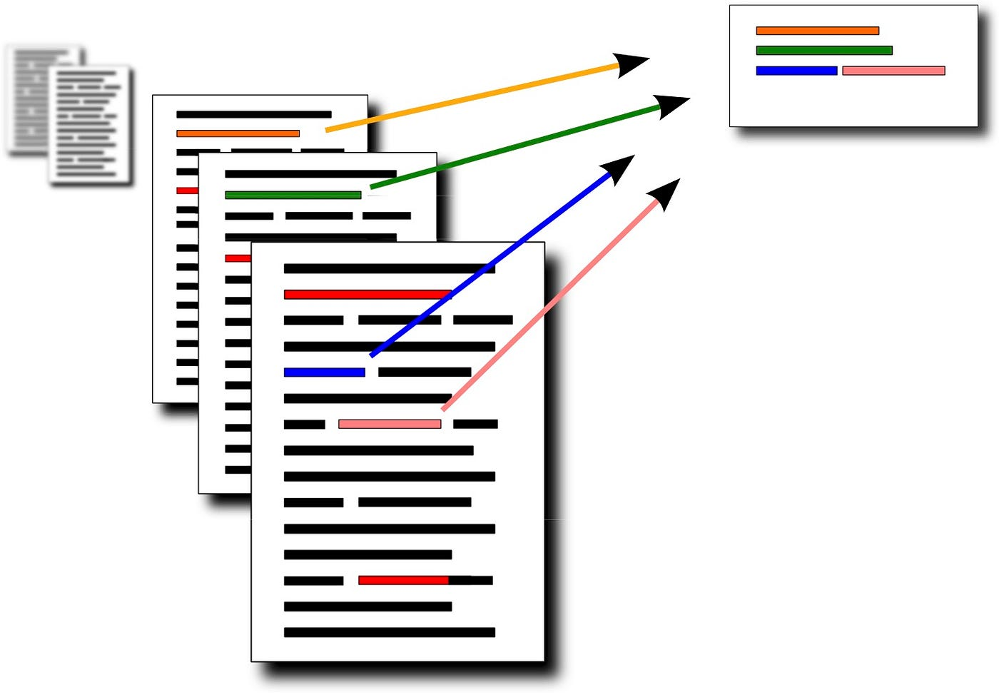
Goal
produce an abridged version of a text that contains information that is important or relevant to a user.
Notes:
What is Text Summarization?
Text summarization is the process of distilling the essential information from a text document into a shorter version while preserving its key points and meaning. It involves reducing the length of the text while retaining its most important ideas, concepts, and arguments. Summarization can be performed manually by humans or automatically by algorithms and natural language processing techniques.
Creating an abridged version serves to streamline information delivery and enhance user experience by providing them with a clear and concise understanding of the text's significance.

Slide 3


Applications of Summarization
outlines or abstracts of any document, article, etc.
action items from a meeting
summaries of email threads
simplifying text by compressing sentences
Notes:
How these applications used in real life scenario?
Let us take one of the application from the above slide and discuss.
Example: Emails
in a busy work environment, employees often receive numerous emails containing lengthy conversations. It’s very difficult to read all the content present in email unless it is very important mail. By summarizing these email threads, individuals can quickly identify the key messages, decisions, and action items without having to read through every message. This not only saves time but also ensures that critical information is not overlooked.
Additionally, summarizing email threads can help teams collaborate more effectively by providing concise updates on ongoing projects and discussions, facilitating clearer communication and decision-making processes.

Slide 4

Categories
Input
Single-Document Summarization (SDS)
Multiple-Document Summarization (MDS)
Output
Extractive
Abstractive
Focus
Generic
Query-focused Summarization
Machine learning methods
Supervised
Unsupervised
Notes:
The slide shows various aspects of text summarization
These categories help classify and understand the diverse approaches and objectives within the field of text summarization, providing a framework for researchers and practitioners to explore and develop summarization techniques tailored to different needs and contexts.

Slide 5
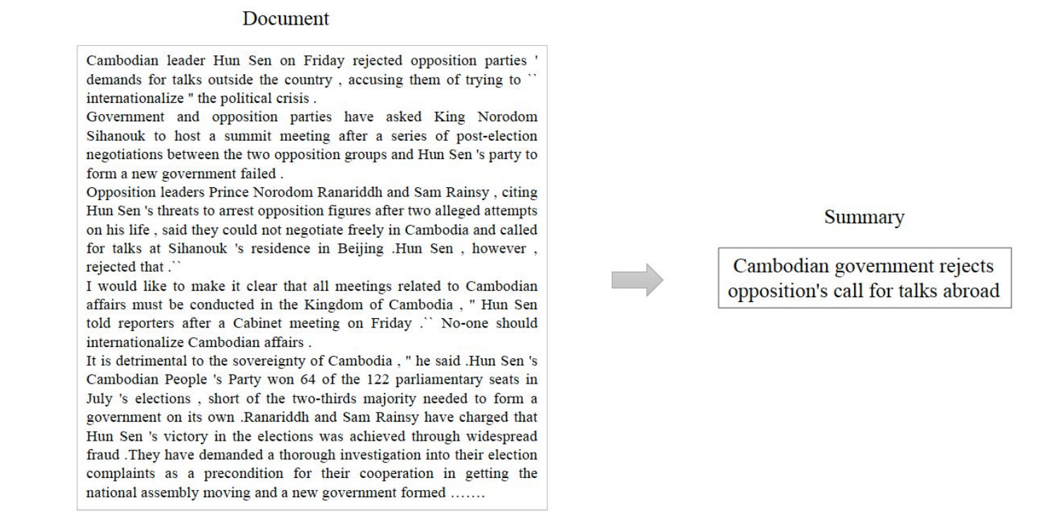
What to summarize? Single-document Summarization
Single-document summarization
Given a single document, produce
abstract
outline
headline
Notes:
How this approach is different from Multi- document summarization? This approach is suitable for scenarios where the information is contained within one document, such as summarizing an article, research paper, or report. single-document summarization focuses on depth within a single source.

Slide 6
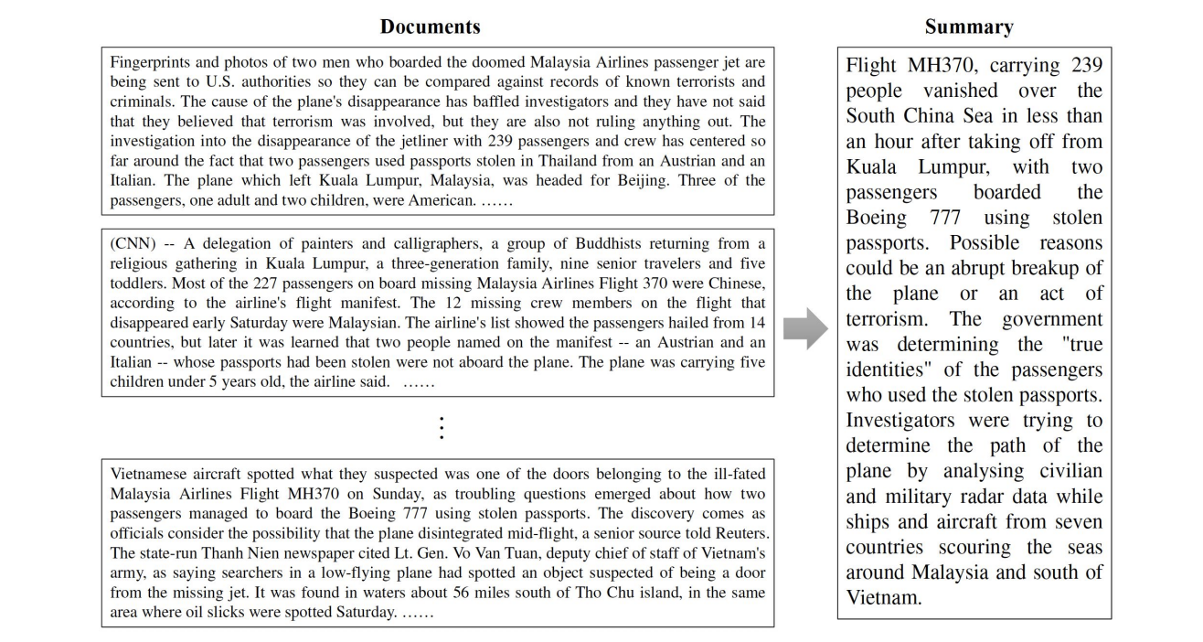
What to summarize? Multiple-document Summarization
Multiple-document summarization
Given a group of documents, produce a gist of the content:
a series of news stories on the same event
a set of web pages about some topic or question
Notes:
How this approach is different from Single- document summarization?.
Multi-document summarization requires analyzing and integrating information from multiple sources to provide a comprehensive overview of a broader topic or subject. This is particularly useful when dealing with large volumes of documents or when seeking to understand different perspectives or viewpoints on a particular issue. Multi-document summarization emphasizes breadth by aggregating and summarizing information across multiple documents.

Slide 7
Generic & Query-focused Summarization
Generic summarization:
* Summarize the content of a document
Query-focused summarization:
* summarize a document with respect to an information need expressed in a user query.
* a kind of complex question answering:
Answer a question by summarizing a document that has the information to construct the answer
Notes:
How this approach is different from the other two methods(Single and multi text summarization)?
Query-focused summarization enables personalized and context-aware information retrieval, facilitating more efficient access to relevant information in diverse application domains such as information retrieval systems, conversational agents, and personalized recommendation systems.
For example, let’s take with generic summarization scenario about news article, these article discusses about climate change and might be summarized to provide a general overview of the main points, such as rising global temperatures, impacts on ecosystems, and efforts to mitigate climate change.
Iin a query-focused summarization scenario, if a user queries "What are the effects of climate change on polar bears?" the summarization system would extract and highlight specific information from the document relevant to the user's query, such as declining sea ice habitat and decreasing polar bear populations.

Slide 8
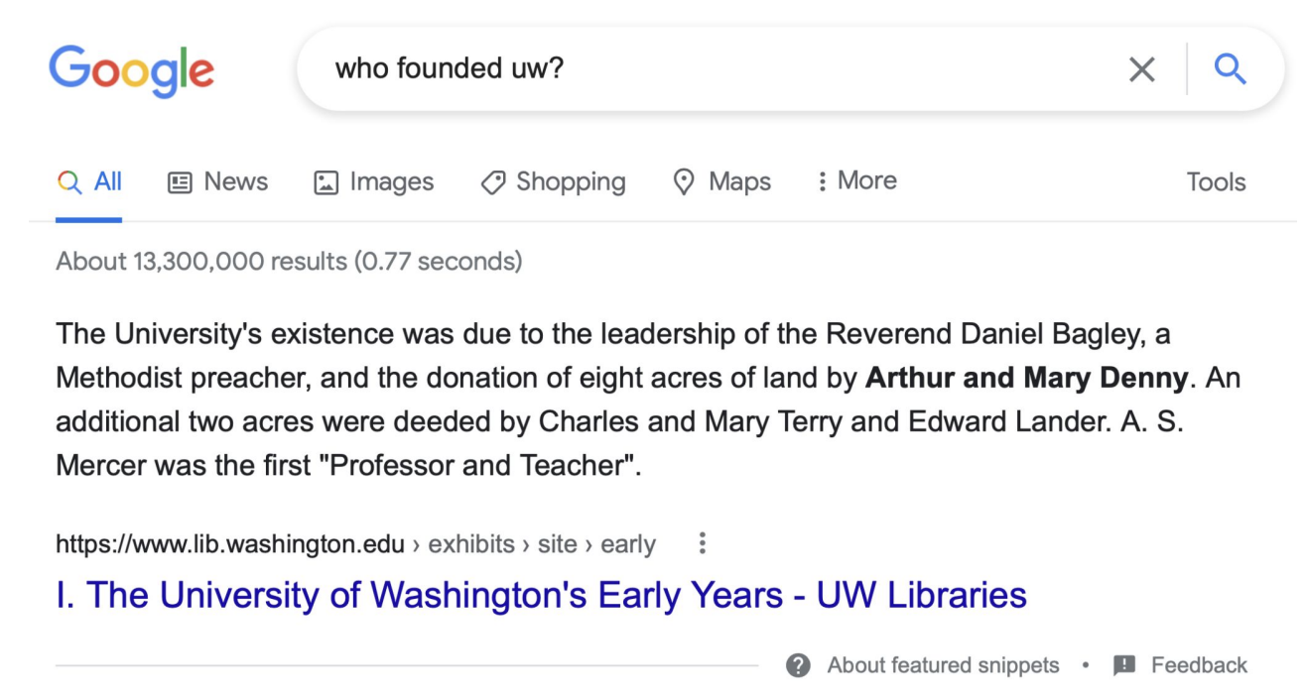
Summarization for Question Answering: Snippets
Create snippets summarizing a web page for a query
Notes:
In the above slide, these type of snippets help users quickly find relevant information and make informed decisions without having to sift through lengthy web pages.
For example, if a user searches for "best restaurants in New York City," search engine results might include snippets from various restaurant review websites containing brief summaries of highly-rated restaurants in New York City, along with key information such as their locations, cuisines, and customer reviews.

Slide 9

Extractive & Abstractive summarization
Extractive summarization:
create the summary from phrases or sentences in the source document(s)
Abstractive summarization:
express the ideas in the source documents using (at least in part) different words
Notes:
For example, consider a lengthy news article reporting on a scientific breakthrough in renewable energy technology.
In an extractive summarization, the summary might consist of verbatim excerpts from the article, providing a condensed version of the key points but retaining the original wording.
In an abstractive summarization, the generated summary could rephrase and synthesize the information from the article into new sentences that convey the same ideas in a more concise and coherent manner.
This might involve condensing complex technical details, paraphrasing explanations, and restructuring sentences to improve readability while retaining the essence of the original content. Abstractive summarization allows for more flexibility and creativity in summarizing the article, resulting in a summary that is not only shorter but also more engaging and accessible to a wider audience.

Slide 10

History of Summarization
Since 1950s:
Concept Weight (Luhn, 1958), Centroid (Radev et al., 2004), LexRank (Erkan and Radev, 2004), TextRank (Mihalcea and Tarau, 2004), Sparse Coding (He et al., 2012; Li et al., 2015)Feature+Regression (Min et al., 2012; Wang et al., 2013)
Most of the summarization methods are extractive. (pre deep learning)
Abstractive summarization is full of challenges.
Some indirect methods employ sentence fusing (Barzilay and McKeown, 2005) or phrase merging (Bing et al., 2015).
The indirect strategies will do harm to the linguistic quality of the constructed sentences.
Notes:
What is the use of knowing the history?
By learning from past approaches and innovations, stakeholders can identify areas for improvement and explore new directions in summarization research. Additionally, understanding the historical context can inform decision-making processes, such as selecting appropriate methods for specific summarization tasks or anticipating potential challenges in implementing summarization solutions.

Slide 11
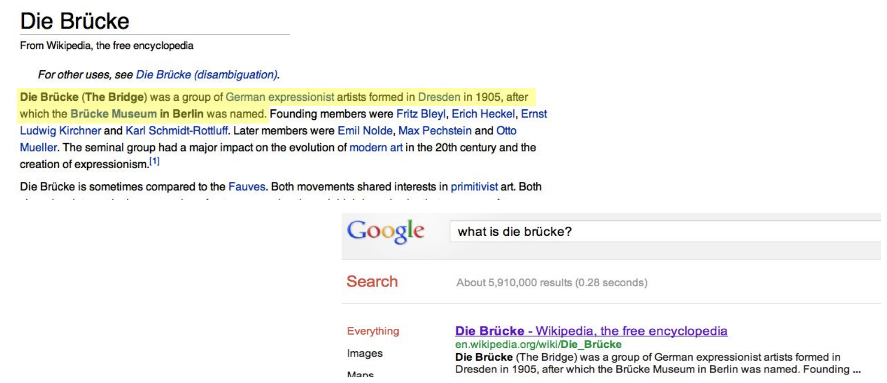
How to detect salient words/sentences? (= Salience Detection) Methods
Simple baseline: take the first sentence
Notes:
Where these detection will be used?
Salience detection is utilized to pinpoint the most significant information within a text document, serving as a foundational step in various natural language processing tasks. By identifying salient words or sentences, this process enables the extraction of key content, essential for tasks such as text summarization, information retrieval, and question answering. Salience detection aids in generating concise and informative summaries, ranking search results based on relevance, and identifying relevant passages for answering user queries. Ultimately, it enhances the efficiency and effectiveness of natural language processing applications by focusing on the most pertinent information within text documents.

Slide 12
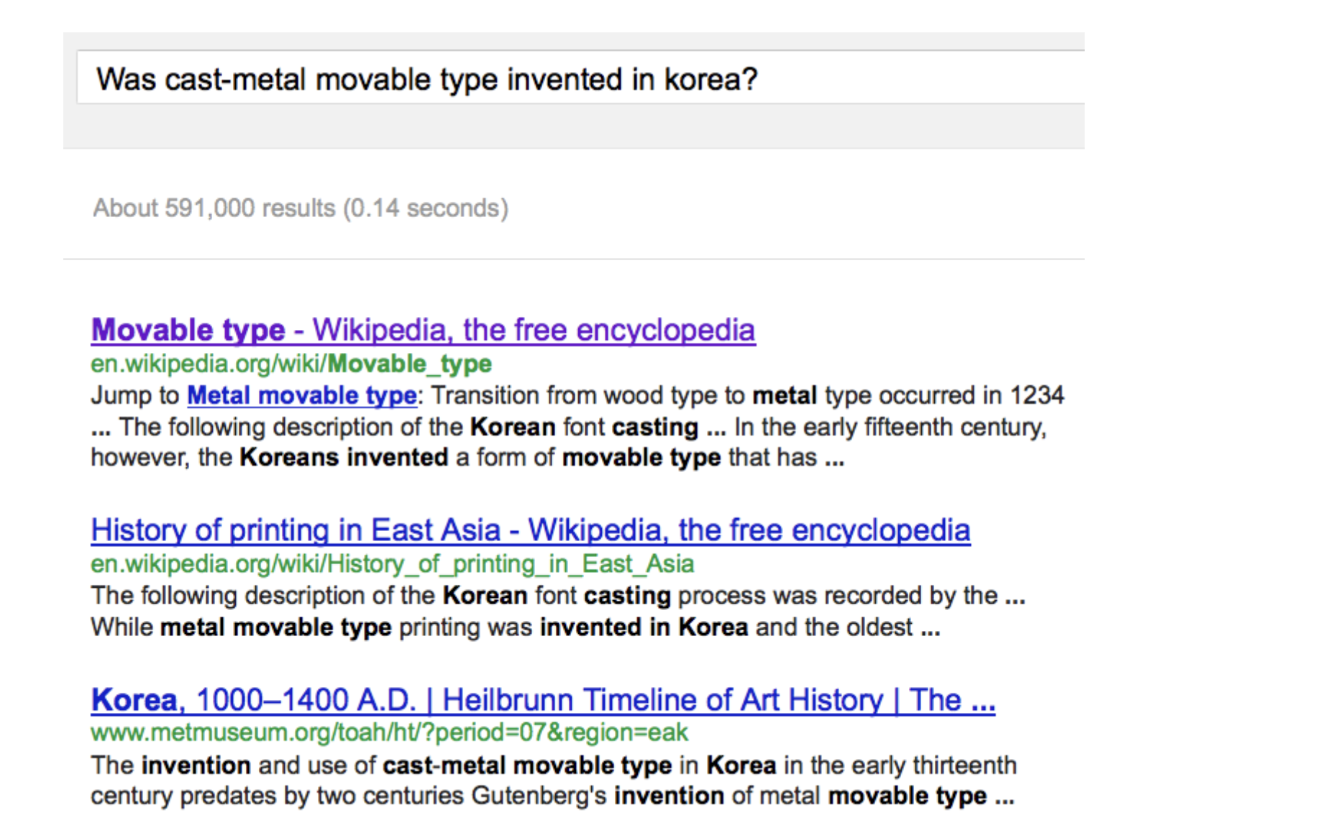
Snippets: query-focused summaries
Notes:
The slide is presenting the concept of query-focused summarization, which involves generating concise summaries tailored to specific user queries or information needs. It emphasizes the importance of providing relevant information in response to a query, highlighting the need for focused and targeted summaries

Slide 13
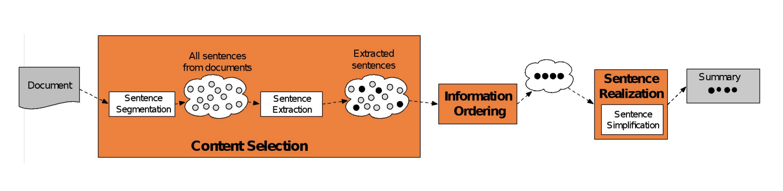
Summarization: Three Stages
1. content selection: choose sentences to extract from the document
2. information ordering: choose an order to place them in the summary
3. sentence realization: clean up the sentences
Notes:
These three steps provide a structured approach to text summarization, guiding the process from selecting relevant content to organizing and refining it into a concise and coherent summary. By following these steps, summarization systems can effectively capture the essence of the original text while producing summaries that are informative, readable, and engaging.

Slide 14

Unsupervised content selection
Intuition dating back to Luhn (1958):
Choose sentences that have salient or informative words
Two approaches to defining salient words
1. tf-idf: weigh each word wi in document j by tf-idf
(tf: term-frequency, idf: inverse-document-frequency)
2. topic signature: choose a smaller set of salient words
Use log-likelihood ratio (LLR) Dunning (1993), Lin and Hovy (2000)
Notes:
The information presented on the slide plays a crucial role in text summarization by addressing the fundamental task of selecting relevant content for inclusion in the summary. Content selection is a critical step in the summarization process, as it determines which information from the original document will be retained and highlighted in the summary
Understanding and applying unsupervised content selection techniques is essential for building robust and effective text summarization systems.

Slide 15
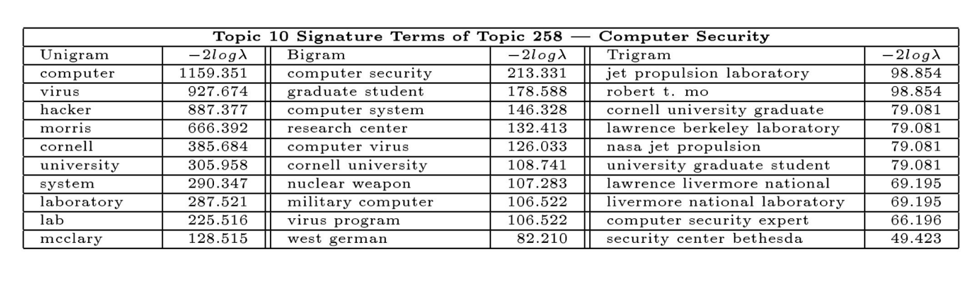
Unsupervised content selection
Topic signature: choose a smaller set of salient words
Notes:
What is Topic Signature?
Topic signature is a method in text summarization that selects key words relevant to the document's topic. By identifying distinctive terms, it captures the main themes efficiently, aiding in generating concise and informative summaries. This approach is pivotal in content selection, ensuring the most relevant information is included.

Slide 16
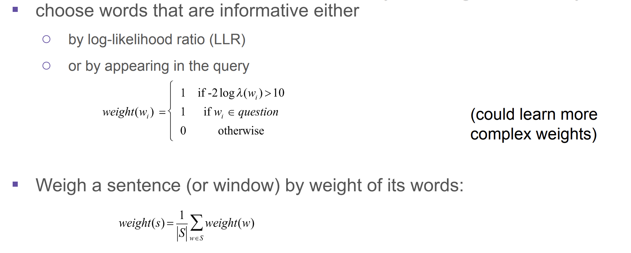
Topic signature-based content selection w/ queries
Conroy, Schlesinger, and O’Leary 2006
Notes:
In the study conducted by Conroy, Schlesinger, and O'Leary in 2006, topic signature-based content selection with queries was explored. This likely involved using topic signature methods to identify salient words or phrases within documents, and then utilizing those signatures to select relevant content in response to user queries. The goal would have been to improve the effectiveness and efficiency of content selection for text summarization, ensuring that the summaries generated are closely aligned with the user's information needs.

Slide 17
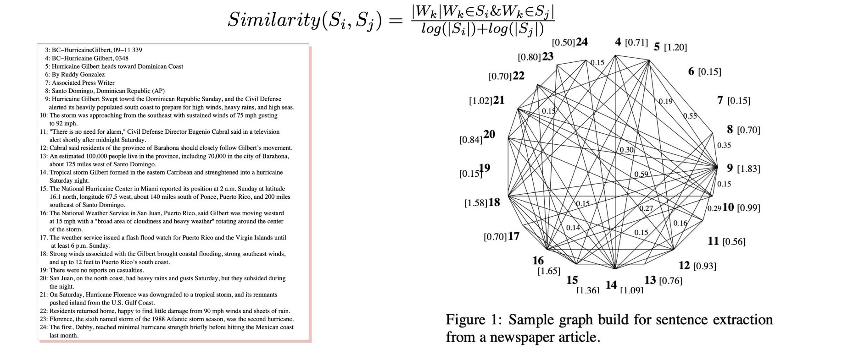
Graph-based Ranking Algorithms
Rada Mihalcea, ACL 2004
unsupervised sentence extraction
Notes:
These algorithms leverage graph structures to rank sentences within a document based on their importance and relevance. By analyzing relationships between sentences and identifying key nodes in the graph, these algorithms facilitate unsupervised content selection for text summarization. This approach enables the extraction of salient sentences without the need for manual annotation or supervision, contributing to the development of more efficient and scalable text summarization techniques.

Slide 18

CNN/DM dataset
Example of a CNN News Article With Highlights from cnn.com
Notes:
The above slide shows the summary of the dataset that is taken from cnn.com.

Slide 19
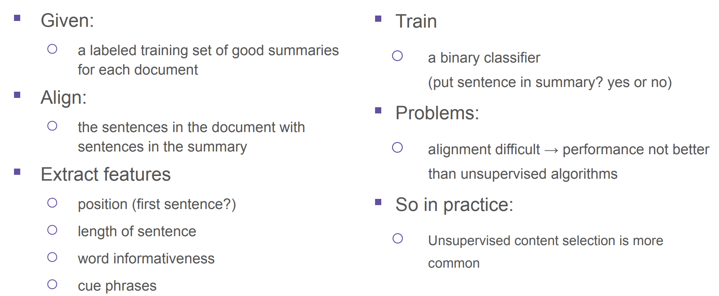
Supervised content selection
Notes:
Supervised content selection in text summarization involves training a model with labeled data to identify the importance of sentences or phrases for summarization tasks. By learning from annotated examples, the model predicts which content is relevant to include in the summary, offering precise control over content selection based on human judgments. This method is valuable when high-quality labeled data is accessible and when fine-tuned content selection is desired for accurate summarization.

Slide 20
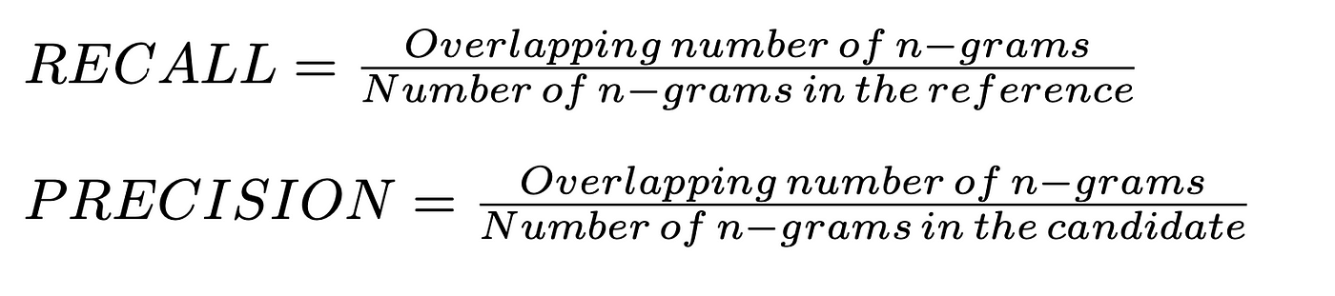
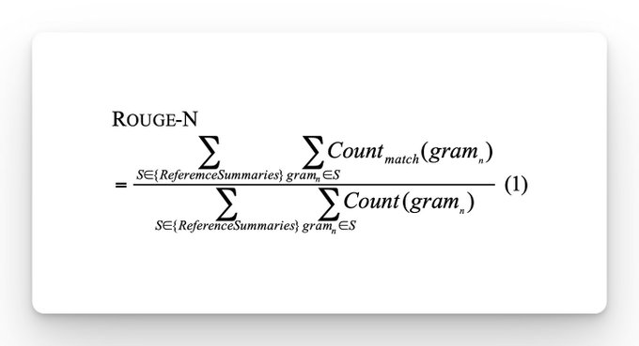
ROUGE-N (Recall Oriented Understudy for Gisting Evaluation)
ROUGE-N measures overlap of N-grams between automatic summaries and reference summaries.
Higher ROUGE-N scores indicate better summary quality.
Indicates similarity between automatic summary and human references.
Convenient automated evaluation metric.
Limited in capturing all aspects of human judgment (relevance, coherence).
Notes:
For example, let's say we have an article about "Benefits of Exercise" and three reference summaries written by humans. We also have an automatic summarization system that generates its own summary of the article.
We choose a value for N, like 2 for bigrams. Then, we count how many bigrams in the automatic summary are also in the reference summaries.
If the automatic summary shares many bigrams with the reference summaries, it will get a higher ROUGE-2 score, indicating better quality.
ROUGE-N provides a quantitative measure of how well the automatic summary captures the content and structure of the human-written reference summaries.

Slide 21
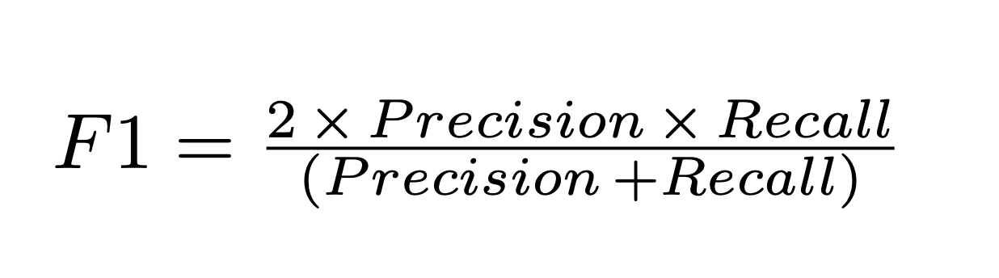
ROUGE-1 (Recall Oriented Understudy for Gisting Evaluation)
ROUGE-1 measures overlap of single words between automatic summaries and reference summaries.
Higher ROUGE-1 scores suggest better alignment between automatic summary and human references at the word level.
Precision: Proportion of unigrams in generated summary also in reference summaries.
Recall: Proportion of unigrams in reference summaries also in generated summary.
ROUGE-1 = (Number of overlapping unigrams)
(Total number of unigrams in reference summaries)
Notes:
For example, let's consider a news article about "Climate Change" with three reference summaries written by humans. We also have an automatic summarization system that generates its own summary of the article.
We calculate the ROUGE-1 score by counting how many individual words in the automatic summary are also present in the reference summaries.
If the automatic summary shares many words with the reference summaries, it will receive a higher ROUGE-1 score, indicating better quality.
ROUGE-1 provides a quantitative measure of how well the automatic summary captures the content and vocabulary used in the human-written reference summaries.

Slide 22
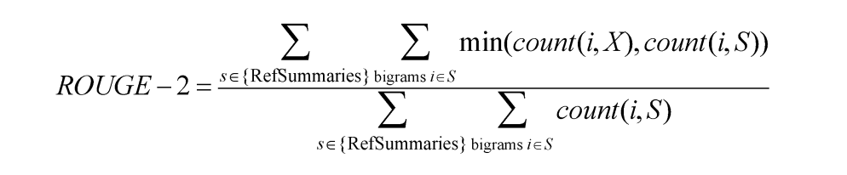
ROUGE-2 (Recall Oriented Understudy for Gisting Evaluation)
A metric for automatically evaluating summaries
Based on BLEU (a metric used for machine translation)
Not as good as human evaluation (“Did this answer the user’s question?”)
But much more convenient
Given a document D, and an automatic summary X:
1. Have N humans produce a set of reference summaries of D
2. Run system, giving automatic summary X
3. What percentage of the bigrams from the reference summaries appear in X?
ROUGE-2 = (Number of overlapping bigrams)
(Total number of bigrams in reference summaries)
Notes:
Example:
Let's consider an article about "Artificial Intelligence" and three reference summaries written by humans. We also have an automatic summarization system that generates its own summary of the article.
We count how many pairs of consecutive words (bigrams) in the automatic summary are also in the reference summaries.
If the automatic summary shares many bigrams with the reference summaries, it will get a higher ROUGE-2 score, indicating better quality.
ROUGE-2 provides a quantitative measure of how well the automatic summary captures the content and structure of the human-written reference summaries at the level of word pairs.

Slide 23
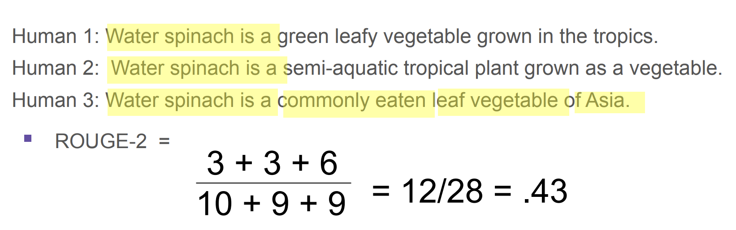
A ROUGE example: Q: “What is water spinach?”
System output: “Water spinach is a leaf vegetable commonly eaten in tropical areas of Asia.”
Human Summaries (Gold)
Notes:
Explaining the above example from the slide.
Counting overlapping bigrams: Determine how many bigrams in the automatic summary are also present in the reference summaries.
Automatic Summary: ["water spinach", "is", "a", "vegetable", "grown", "in", "the", "tropics"]
2. Count of overlapping bigrams:
Human 1: 3 (["water spinach", "is", "a"])
Human 2: 3 (["water spinach", "is", "a"])
Human 3: 3 (["water spinach", "is", "a"])
Calculation: Add up the counts of overlapping bigrams and divide by the total number of bigrams in the reference summaries.
Total overlapping bigrams: 3 + 3 + 3 = 9 Total number of bigrams in reference summaries: 28
ROUGE-2 = 9/28 ≈ 0.43
So, the ROUGE-2 score for the given human-written reference summaries is 0.43.

Slide 24
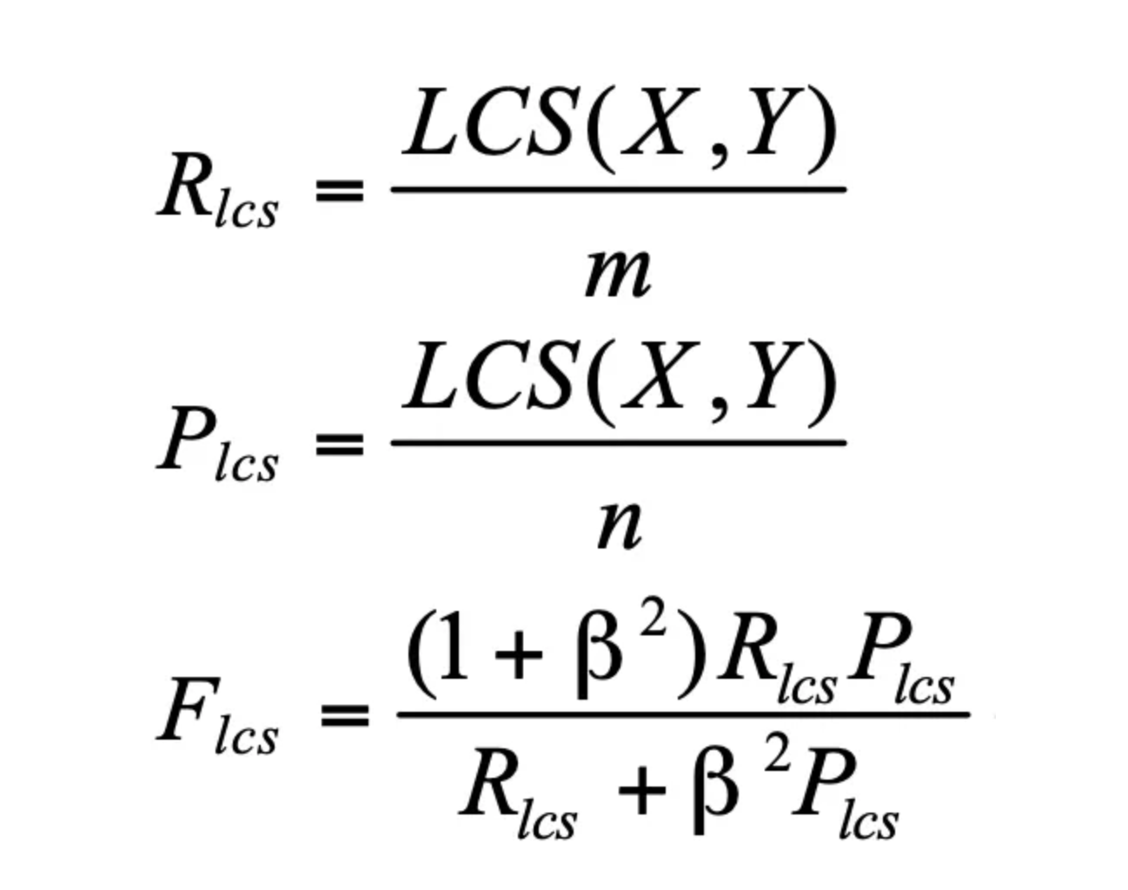
ROUGE-L (Recall Oriented Understudy for Gisting Evaluation)
ROUGE L considers the order of words, penalizing summaries that reorder words significantly.
It measures the overlap of words between the generated summary and the reference summary.
ROUGE L calculates the longest common subsequence (LCS) between the two summaries.
Notes:
Suppose we have a news article discussing "Renewable Energy Sources" and three reference summaries written by humans. We also have an automatic summarization system that generates its own summary of the article.
In this case, we calculate the longest common subsequence (LCS) between the automatic summary and each reference summary. The LCS represents the longest sequence of words that appear in both the automatic summary and the reference summary.
For example, if the automatic summary shares a long common subsequence with the reference summaries, it will receive a higher ROUGE-L score, indicating better alignment and summarization quality.
ROUGE-L serves as a quantitative measure of how effectively the automatic summary captures the key information and structure present in the human-written reference summaries.

Slide 25
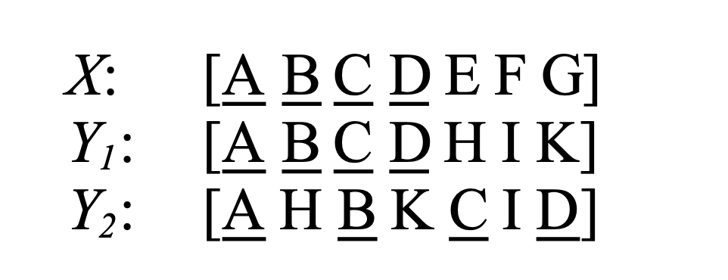
ROUGE-W (Recall Oriented Understudy for Gisting Evaluation)
It considers the weighted overlap of n-grams between the generated summary and the reference summary.
It provides a more nuanced evaluation compared to ROUGE L, as it considers multiple n-gram lengths simultaneously.
ROUGE W can be customized to focus on specific n-gram lengths, such as unigrams, bigrams, or trigrams.
ROUGE-W = (Weighted Length of WLCS)
(Total number of words in reference summaries)
Notes:
Example:
Suppose we have an article about "Space Exploration" and three reference summaries written by humans. We also have an automatic summarization system that generates its own summary of the article.
In this case, we calculate the weighted longest common subsequence (WLCS) between the automatic summary and each reference summary. The WLCS considers the importance or weight of each word in the subsequence.
For instance, if the automatic summary shares a long common subsequence with the reference summaries, with important words receiving higher weights, it will get a higher ROUGE-W score, indicating better alignment and summarization quality.
ROUGE-W provides a quantitative measure of how effectively the automatic summary captures the essential content and structure present in the human-written reference summaries, considering the importance of individual words.

Slide 26
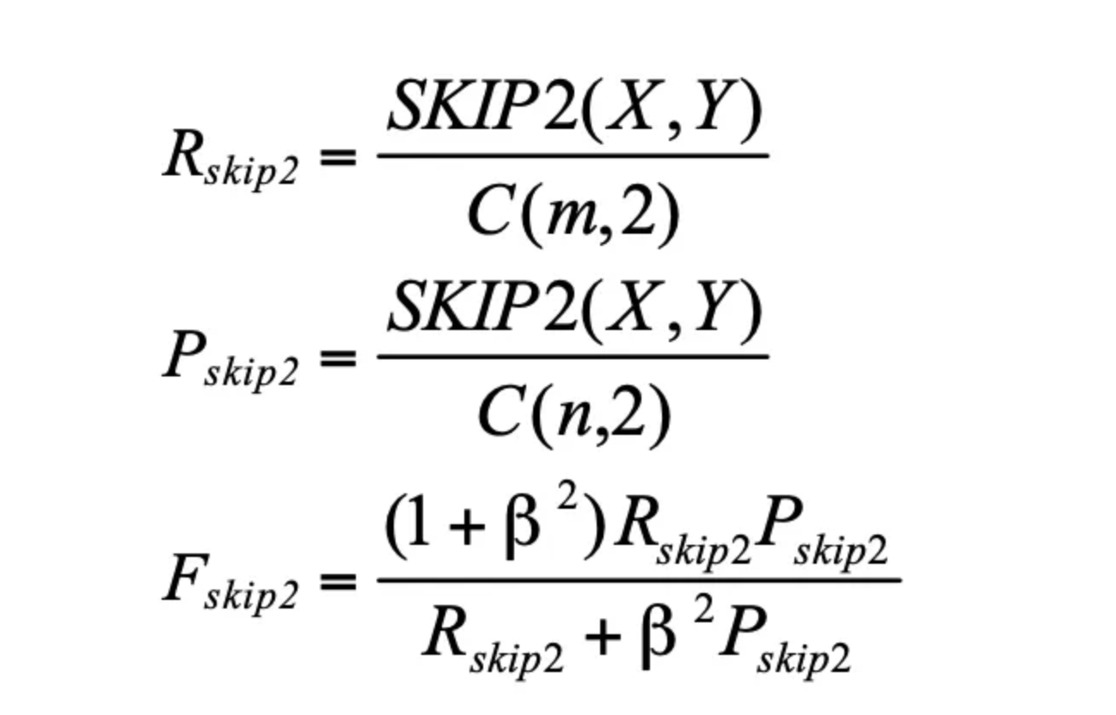
ROUGE-S (Recall Oriented Understudy for Gisting Evaluation)
It measures how well the sentences in the generated summary match the sentences in the reference summary.
This metric helps assess the coherence and informativeness of the generated summary.
It's particularly useful for evaluating abstractive summarization models that generate novel sentences.
Higher ROUGE S scores indicate better sentence-level similarity between the generated and reference summaries.
Notes:
Example:
Suppose we have an article about "Climate Change" and three reference summaries written by humans. We also have an automatic summarization system that generates its own summary of the article.
In this case, we calculate the number of skip-bigrams (pairs of words with a specified maximum gap) that appear in both the automatic summary and each reference summary.
If the automatic summary shares many skip-bigrams with the reference summaries, it will get a higher ROUGE-S score, indicating better alignment and summarization quality.
ROUGE-S provides a quantitative measure of how effectively the automatic summary captures the essential content and structure present in the human-written reference summaries, considering skip-bigrams to capture more flexible word relationships.

Slide 27
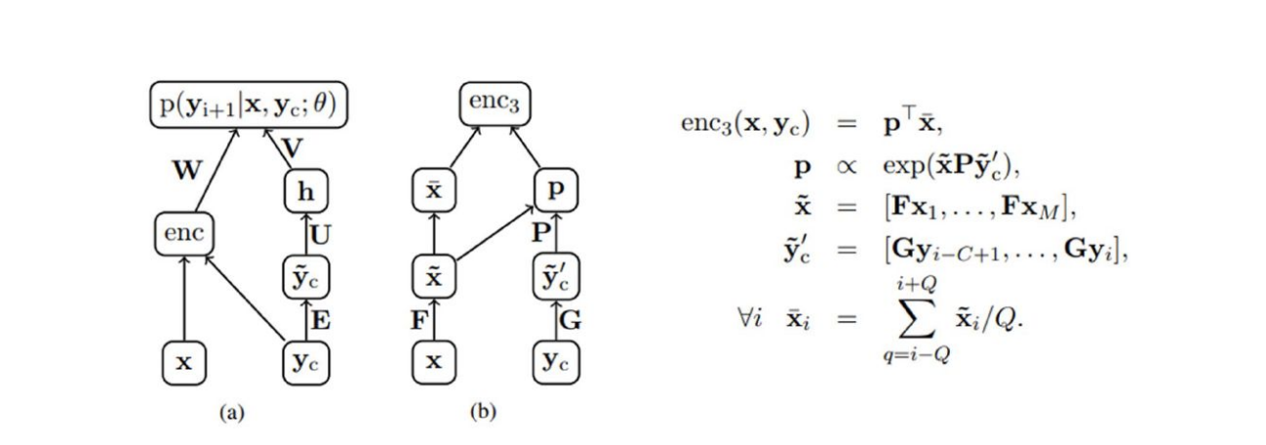
Neural Text Summarization
Rush et al., EMNLP 2015
A neural attention model for abstractive sentence summarization
Inspired by attention-based seq2seq models (Bahdanau, 2014)
Figure (a) NNLM decoder with additional encoder element (b) Attention based encoder
Notes:
These figures from the above slide demonstrate innovative approaches to text summarization, emphasizing the importance of context understanding and attention mechanisms in enhancing summarization quality. From these illustrations, researchers and practitioners can learn about the significance of architectural modifications and attention mechanisms in improving the effectiveness of neural network models for abstractive text summarization tasks.

Slide 28
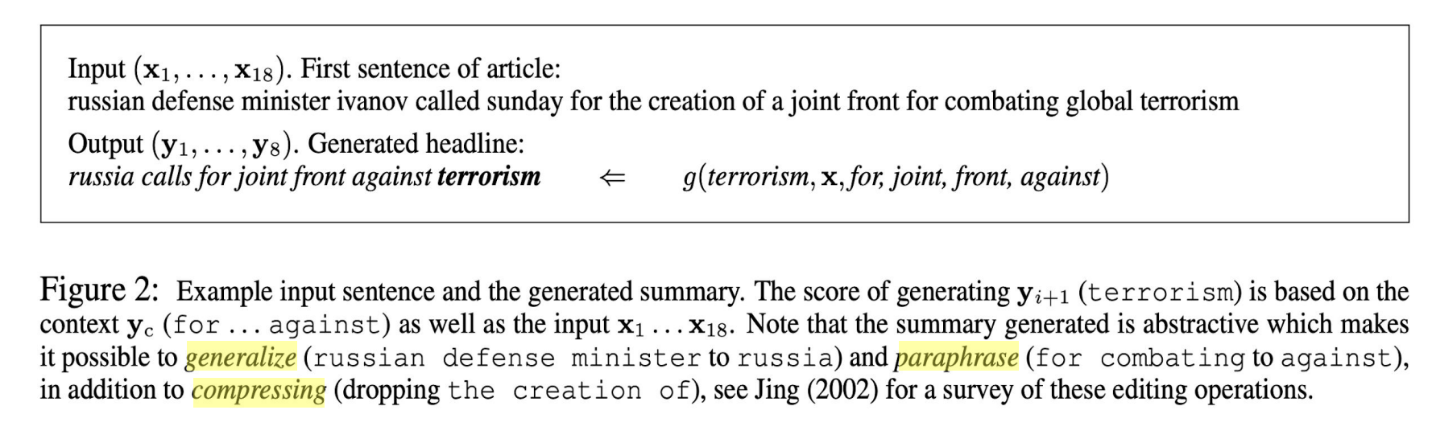
A neural attention model for abstractive sentence summarization
Inspired by attention-based seq2seq models (Bahdanau, 2014)
Notes:
From the above slide, we can learn about the importance of attention mechanisms in improving the performance of text summarization systems. Attention allows the model to selectively attend to relevant information, enabling it to generate more accurate and coherent summaries. This approach represents a significant advancement in the field of text summarization, offering a promising method for enhancing the quality of abstractive summarization.

Slide 29
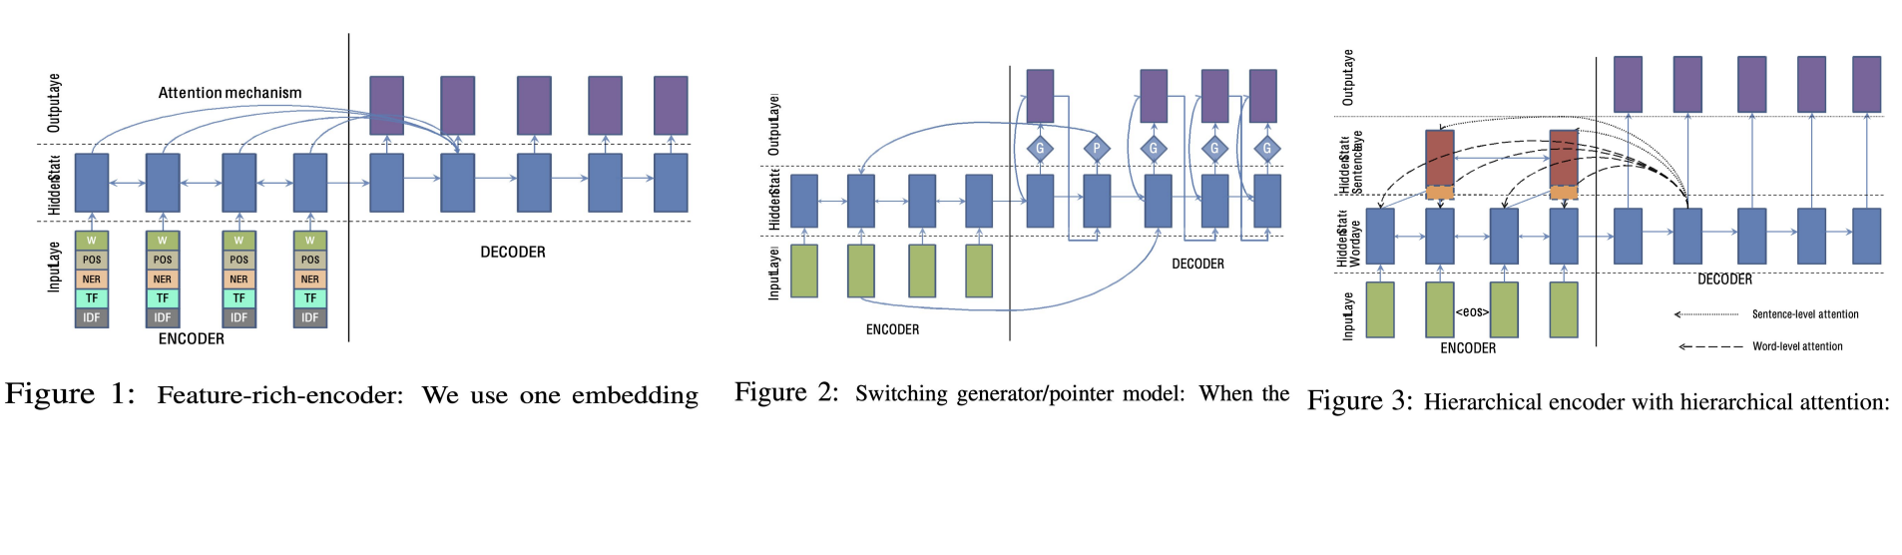
Abstractive Text Summarization using Sequence-to-sequence RNNs and Beyond
Nallapati et al., CoNLL 2016
Implements many tricks (nmt, copy, hierarchical, external knowledge…)
Notes:
By incorporating these tricks into their models, the authors aimed to enhance the performance and versatility of neural networks in tasks such as text summarization, machine translation, and question answering. Their work represents an innovative approach to leveraging neural network architectures and advanced techniques to address challenges in natural language processing, offering insights into the development of more effective and adaptable text generation systems.

Slide 30
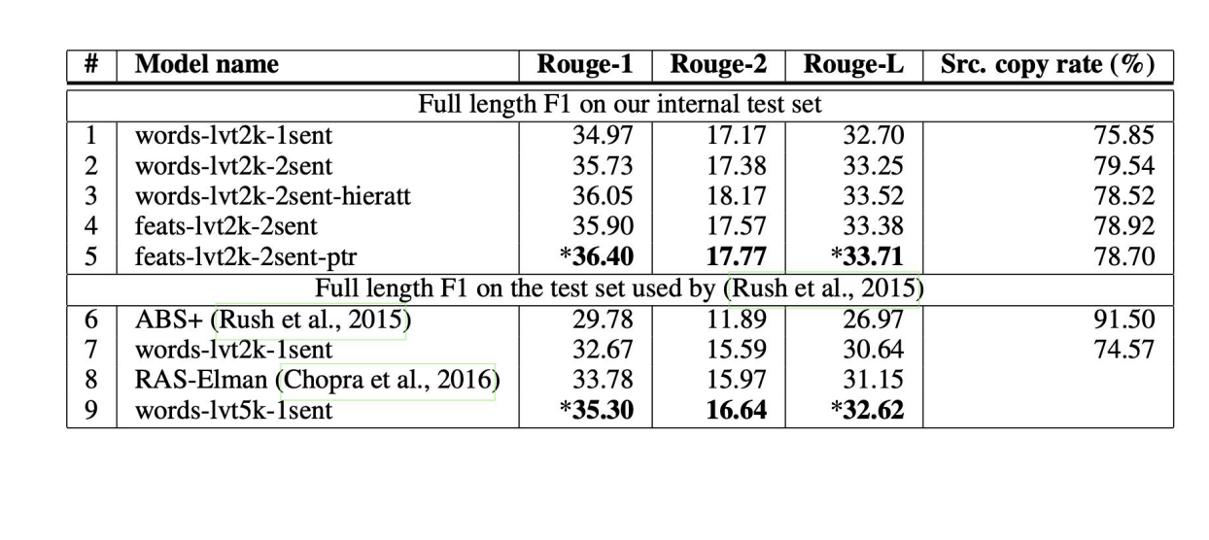
Abstractive Text Summarization using Sequence-to-sequence RNNs and Beyond
Implements many tricks (nmt, copy, coverage, hierarchical, external knowledge)
Hierarchical encoder showed mixed results
Word-level features slightly helpful
Copy mechanism leads to the best performance (ptr)
Notes:
The slide explores the complexities of generating succinct and coherent summaries that accurately represent the core content of the source text. Through the utilization of sophisticated techniques including attention mechanisms, copy mechanisms, and the integration of external knowledge sources, it illustrates the capacity to enhance the caliber and efficiency of abstractive summarization.

Slide 31
Copy Mechanism
OOV, Extraction
"Pointer networks" (Vinyals et al., 2015 NIPS)
"Pointing the Unknown Words” (Gulcehre et al., ACL 2016)
" Incorporating Copying Mechanism in Sequence-to-Sequence Learning " (Gu et al., ACL 2016)
" Get To The Point: Summarization with Pointer-Generator Networks " (See et al., ACL 2017)
Notes:
This mechanism is particularly useful for handling out-of-vocabulary (OOV) words and retaining specific details or entities from the source text. The slide highlights several papers that have contributed to the development and implementation of the copy mechanism in sequence-to-sequence learning models for text summarization.

Slide 32
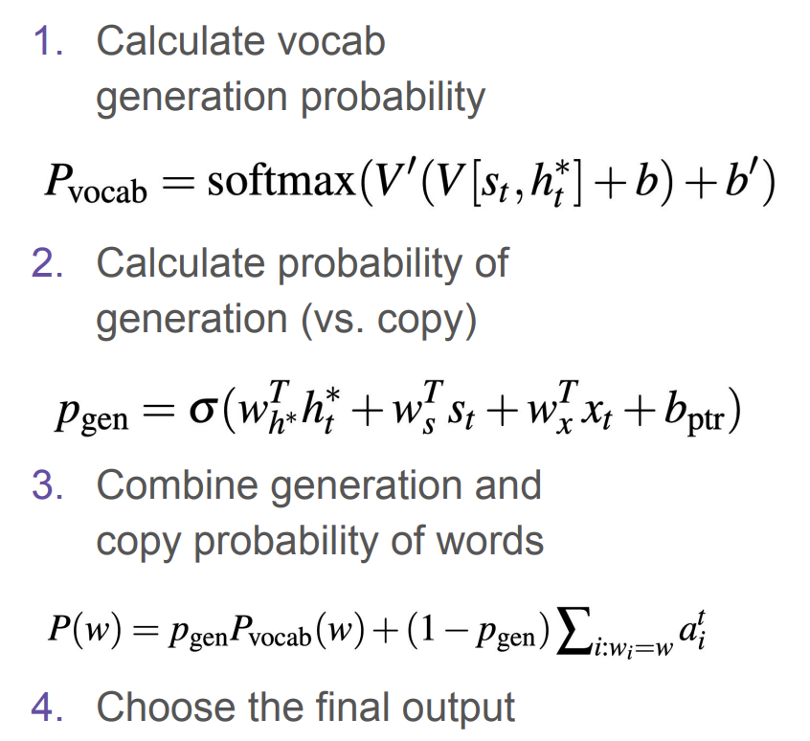
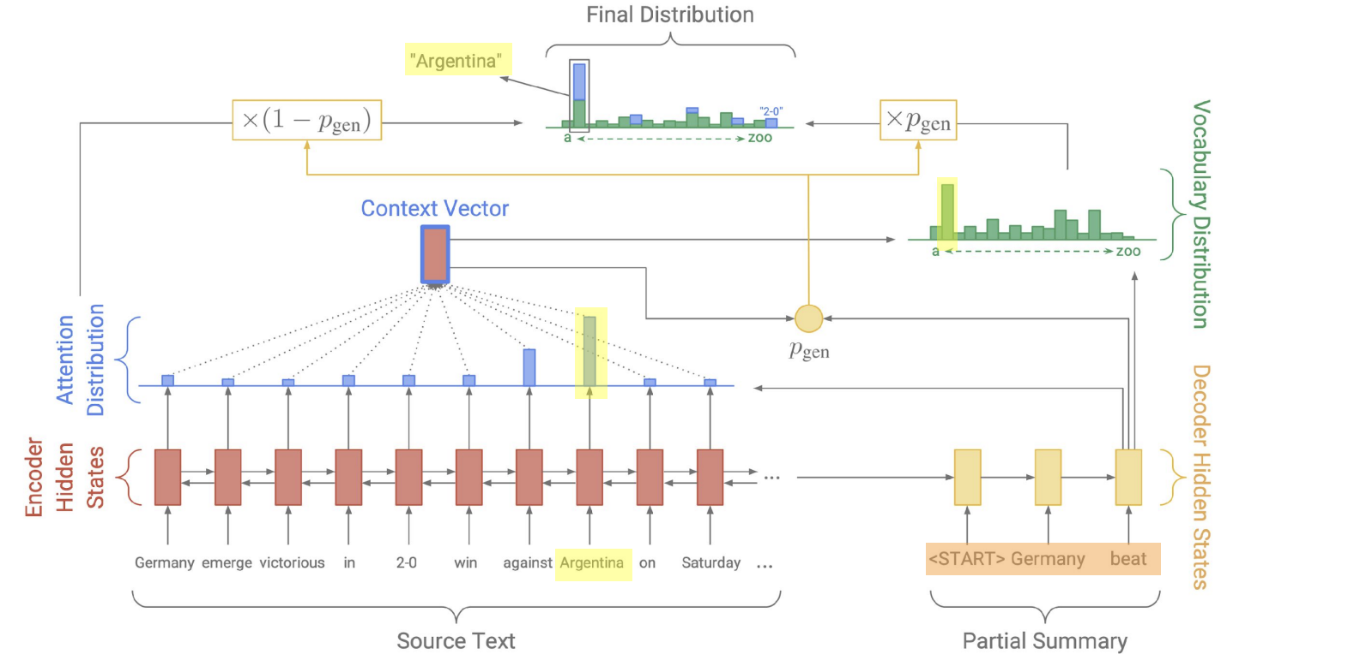
Pointer Generator Networks
See et al., ACL 2017
Copy words from the source text
Notes:
This approach introduces a novel method that integrates a pointer mechanism, allowing the model to directly copy words from the source text into the generated summary. By combining the strengths of both extractive and abstractive summarization methods, Pointer Generator Networks address challenges such as out-of-vocabulary words and produce summaries that are more accurate and informative.

Slide 33
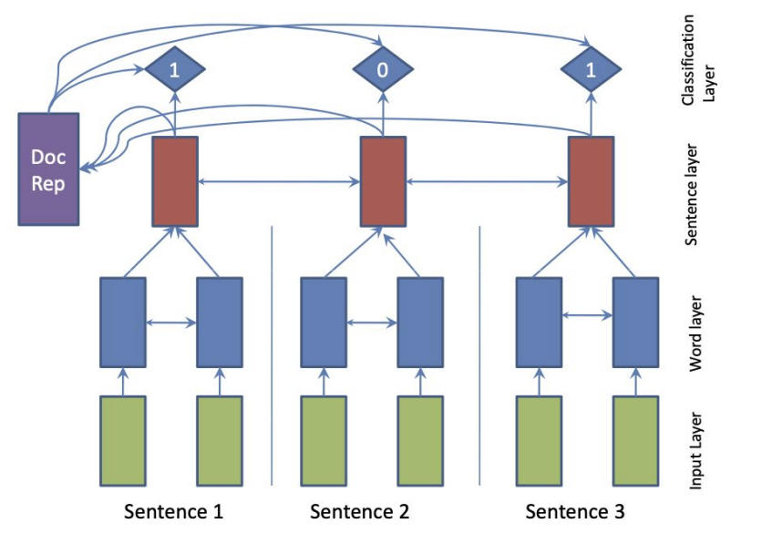
Neural Extractive Models
"SummaRuNNer: A Recurrent Neural Network Based Sequence Model for Extractive Summarization of Documents.” (Nallapati et al., AAAI 2017)
Notes:
From the above slide, these models leverage neural network architectures to learn representations of the input text and predict the salience or importance of each sentence. By training on labeled data where sentences are annotated as either relevant or irrelevant to the summary, neural extractive models learn to identify key information and extract it to form a coherent summary

Slide 34
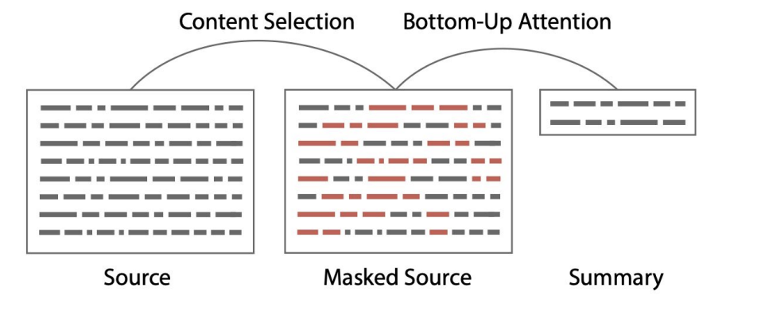
Hybrid approach
" Bottom-Up Abstractive Summarization ” (Gehrmann et al., EMNLP 2018)
“a common mistake made by neural copy models is copying very long sequences or even whole sentences.”
Figure: Overview of the selection and generation processes described throughout Section 4
Notes:
What is Hybrid approach?
A hybrid approach in text summarization refers to a methodology that combines elements from both extractive and abstractive summarization techniques. This approach aims to leverage the strengths of each method to produce more accurate and coherent summaries.

Slide 35
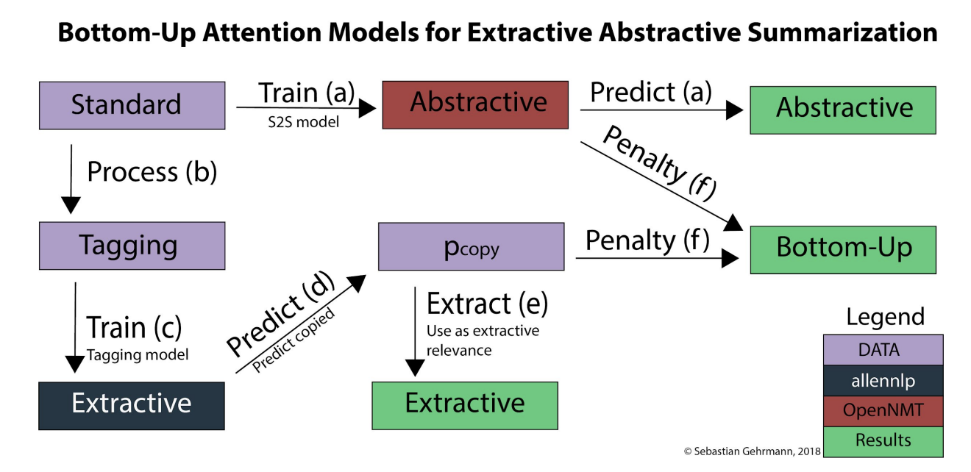
Hybrid approach
"Bottom-Up Abstractive Summarization” (Gehrmann et al., EMNLP 2018)
Notes:
In a hybrid approach, the summarization system may first use an extractive method to identify key sentences or passages from the source text. These extracted segments serve as the foundation of the summary, capturing the most salient information. Then, an abstractive method may be employed to rephrase and refine the extracted content, generating a more concise and coherent summary.

Slide 36
Conclusion
Salience Detection
How to detect important/relevant words or sentences?
Remaining Challenges
Long text abstractive summarization
Abstractive multi-document summarization
Notes:
These points provide insights into the techniques and challenges involved in the field of text summarization, offering guidance for researchers and practitioners seeking to develop effective summarization systems.

